Slide 1
Mobile application development
MINI PROJECT
CAR RACE GAME

Slide 2
INTRODUCTION
Android Studio is the official integrated development environment (IDE) for Google's Android operating system, built on JetBrains' IntelliJ IDEA software and designed specifically for Android development. Android Studio offers even more features that enhance your productivity when building Android apps, such as: A fast and feature-rich emulator, A unified environment where you can develop for all Android devices, Code templates and GitHub integration to help you build common app features and import sample code and so on.
In this mini project, we have incorporated various features of Android Studio to build a 2D car game. The main objective of this game is to drive the car for as long as possible while also avoiding obstacles that could damage the car.

Slide 3
ABSTRACT
A 2-dimensional car game where the player drives a car on a three-lane road that never ends. Through the course the player encounters obstacles in the form of other cars that are moving in the opposite direction as the player. The main objective of this game is to drive the car as much as possible for a high score while avoiding being hit by other cars. Once the player is hit by another car, the game ends and the final score achieved by the player is displayed. Here user’s game score is measured based on the distance travelled by the car: more the distance travelled, higher is the score.
It also has powerups and exciting gifts which makes the game more interesting. This game features simple graphics and user-friendly interface through which any new player can get an understanding of the game objective and mechanics in the first go.

Slide 4
Input AND OUTCOME
INPUT
The input for this game include left and right arrow keys.
Spacebar will pause the game.
OUTCOME
When left or right arrow key is used car moves left and right respectively.
When spacebar is used the game will pause.

Slide 5
SPECIFICATIONS
SOFTWARE SPECIFICATIONS
Android Studio
HARDWARE SPECIFICATIONS
Processor: i5 Core Processor
Monitor: 1024 * 768 Resolution Colour
Keyboard: QWERTY RAM: 1 GB
Motherboard: 845c Intel Motherboard
Hard disk: 2 TB HDD
I/O Device: Standard input and output devices.

Slide 6
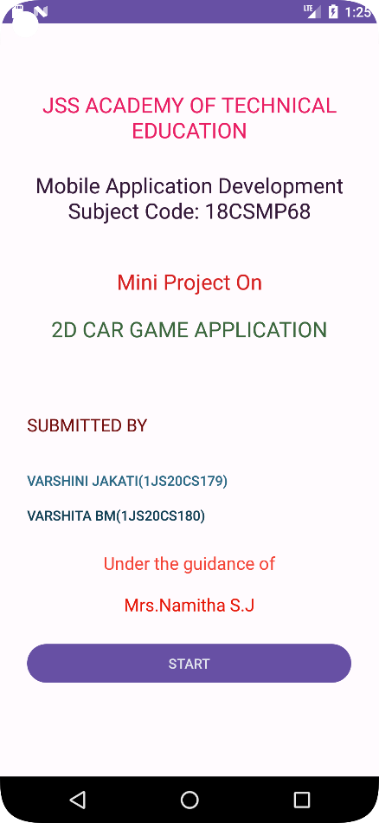
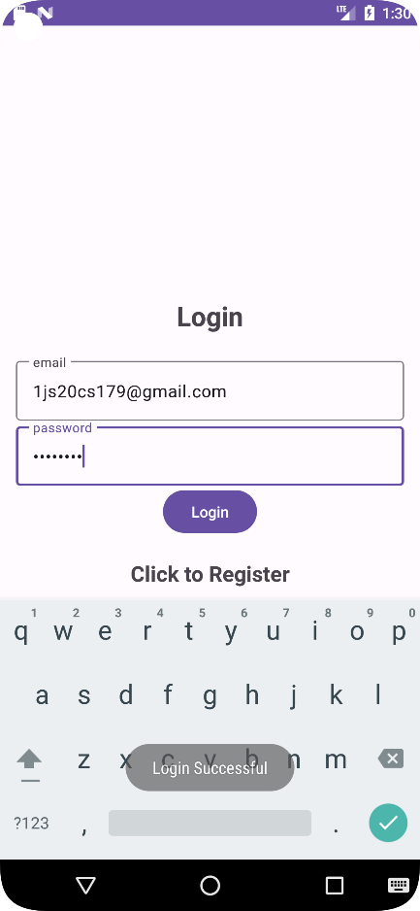
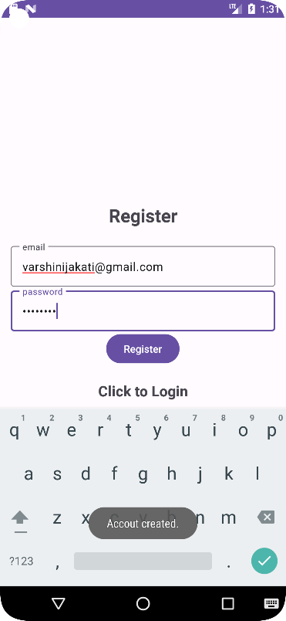
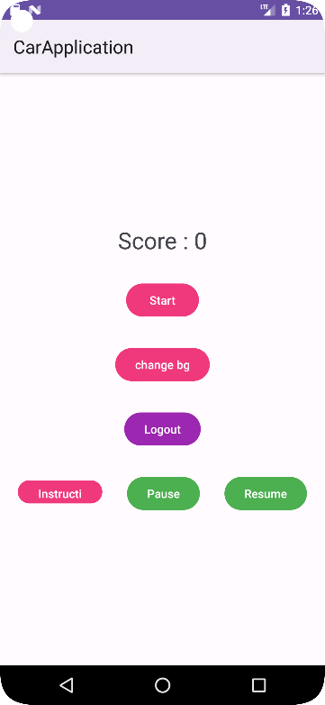
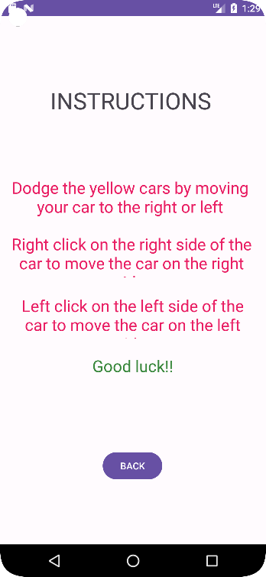
SNAPSHOTS
Fig 1.9.1 Front Page
Fig 1.9.2 login Page
Fig 1.9.3 Register Page
Fig 1.9.4 Main menu
Fig 1.9.5 Instructions Page

Slide 7
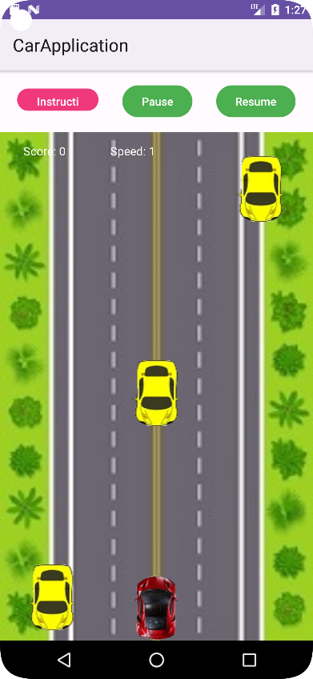
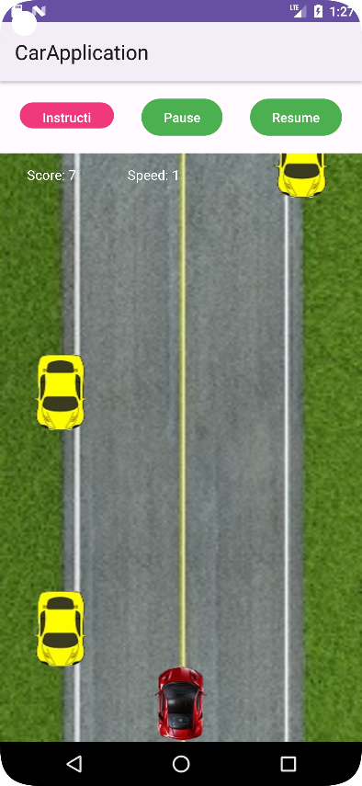
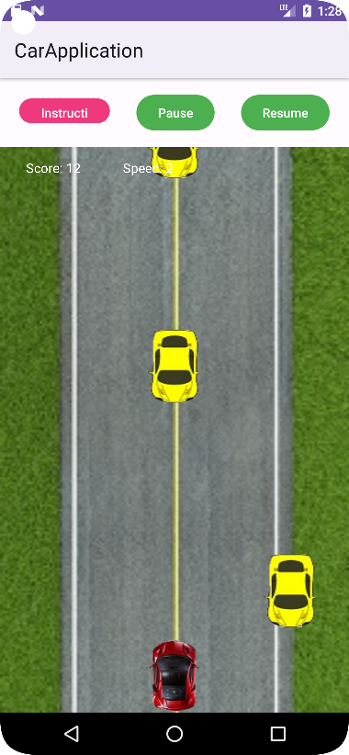
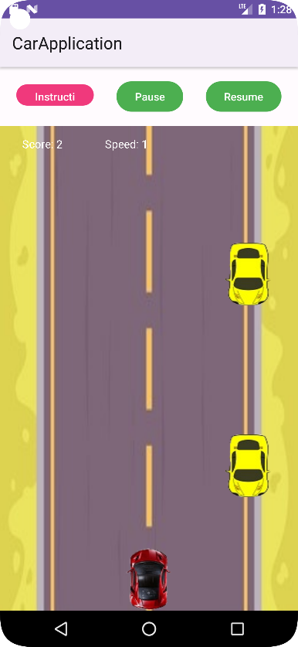
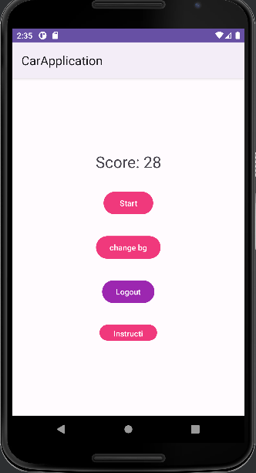
SNAPSHOTS
Fig 1.9.6 Game screen
Fig 1.9.7 Game paused
Fig 1.9.8 Game resumed
Fig 1.9.9 Change background
Fig 1.9.10 Game over screen

Slide 8
CONCLUSION
The proposed system is an Android mobile game developed in Android Studio using Kotlin language. The mobile game in question is a 2D car game which involves a player controlling the movement of a car.
The 2D car game developed is simple and a fun game to play. A user of any age can find this game relaxing and entertaining. In today’s world gaming application plays an important role as it offers entertainment, social interaction, technological advancements. They have become an important aspect of modern world, shaping how people interact with technology. This application incorporates usage of cloud services such as Google Firebase for authentication of accounts created by the users to play this game.
This application can be easily run on any android device as it requires minimum android version 7 and it is essential to create games that are not only fun and engaging but also optimized for the platforms they are intended to run on.
This game will provide an engaging and an enjoyable gaming experience that challenges player’s skills, provides excitement, encourages competition, and promotes cognitive development.

